Slide 1
My Taxi Service
Project of Software Engineering II
Students:
Giuseppe Manzi (mat. 854470)
Alessandro Nicolini (mat. 858858)

Slide 2
Assignment 1: RASD
Requirement Analysis and Specification Document

Slide 3
WHAT IS?
ORIENTED TO
THE CLIENTS
ORIENTED TO THE PROGRAMMERS
It’s a document
UNAMBIGUOUS

Slide 4
SO…
ORIENTED TO
THE CLIENTS
ORIENTED TO THE PROGRAMMERS
Very detailed requirements
Few words
Many schemas (UML)
UNAMBIGUOUS

Slide 5
LEADING IDEA
We assumed not to have any pre-existent computerized information system
WE DECIDED TO PROJECT A SOFTWARE THAT DOES EXACTLY WHAT THE ACTUAL SYSTEM DOES

Slide 6
G2
Allow taxi drivers to have a personal reserved area that helps them managing rides.
G3
G1
GOALS
G4
G5

Slide 7
Allow guest users to request a taxi to reach him to a specific address as soon as possible.
G2
G1
G3
GOALS
G4
G5

Slide 8
Allow costumer to
have a personal reserved area. In addition to functionalities provided to guest users, a registered costumer can reserve a taxi for a specific time, check previous requests and reservations
and modify or delete them
G2
G1
G3
GOALS
G4
G5

Slide 9
G2
G1
G3
GOALS
Guarantee a fair queue management
G4
G5

Slide 10
G2
G1
G3
GOALS
Manage the distribution of the taxis in each zone and notify taxi drivers the need to move from a zone to
another one.
G4
G5

Slide 11
REUIREMENTS
related to G2
3.2.2 - [G2] Allow guest users to request a taxi to reach him to a specific address as soon as possible.
[R2.1] Guest users can insert an address and a mobile phone number and ask for a taxi coming as soon as possible to there.
[R2.2] If enough taxis are available, the system assigns one of them to each incoming guest request.
[R2.3] The code of the taxi assigned to a guest request is sent by SMS to the number the costumer provided during the request.

Slide 12
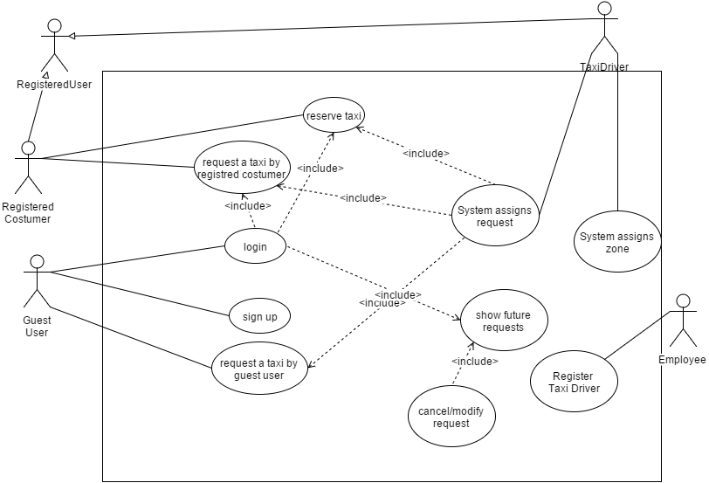
USE CASES

Slide 13
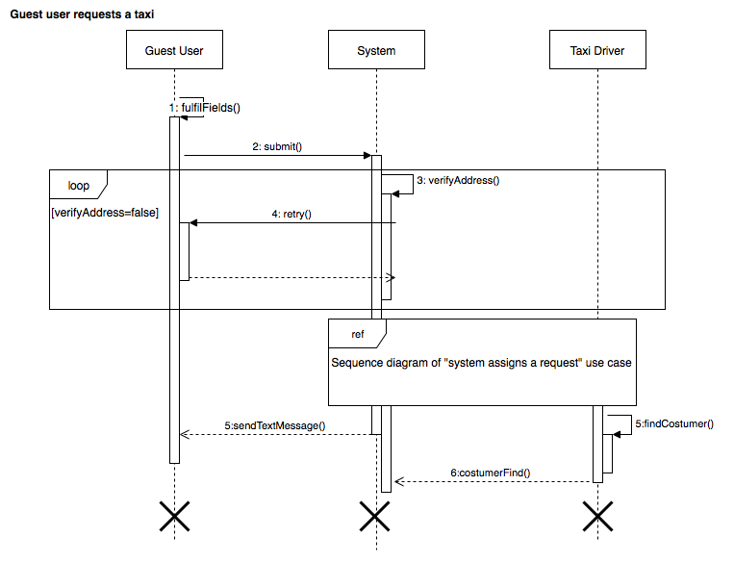

A USE CASE

Slide 14
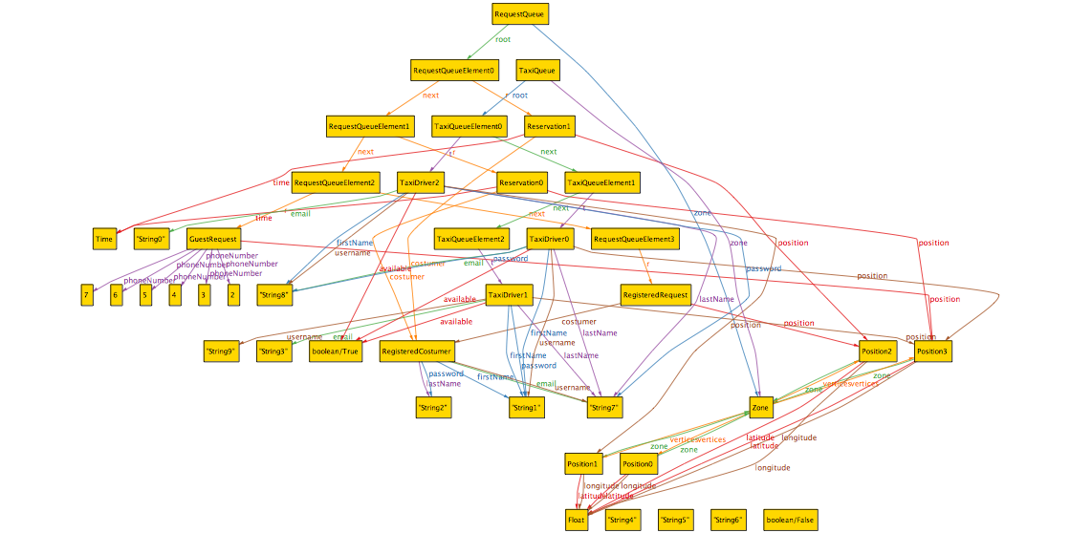
ALLOY STATE SPACE

